Slide 1
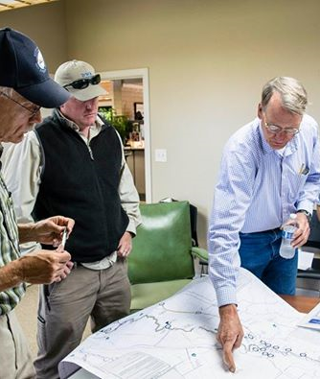
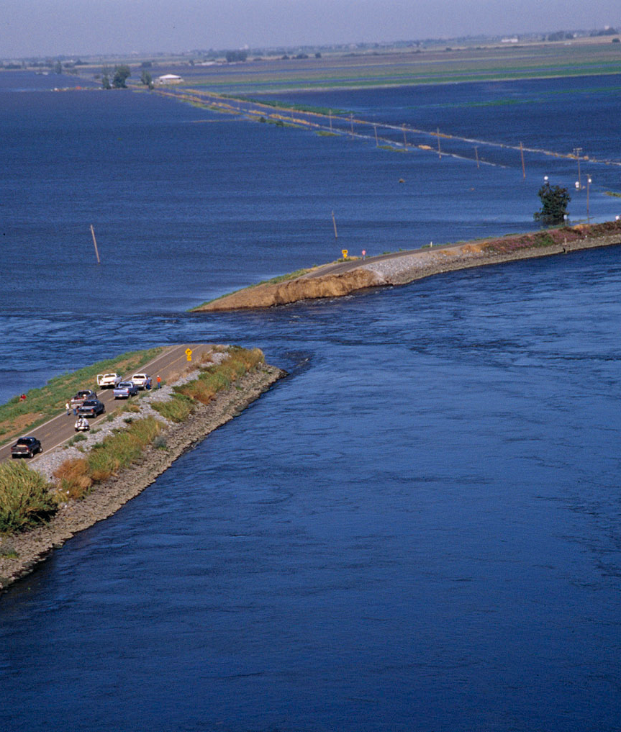
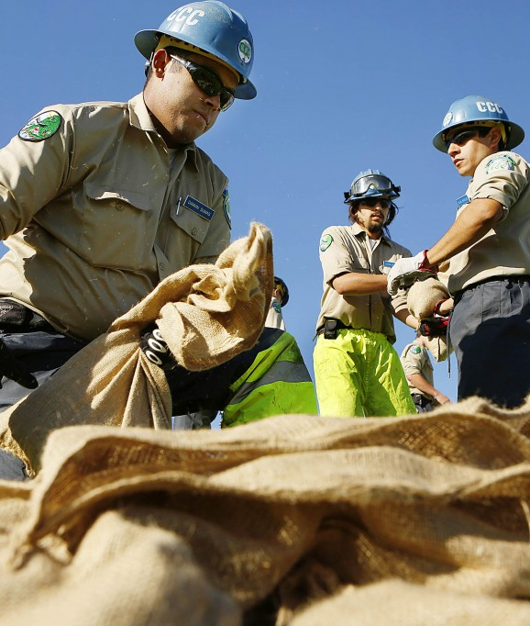



Jones Break, 2004
Creating a Regional
Flood Response System
Central Valley Flood Protection Board
March 25th , 2016

Slide 2
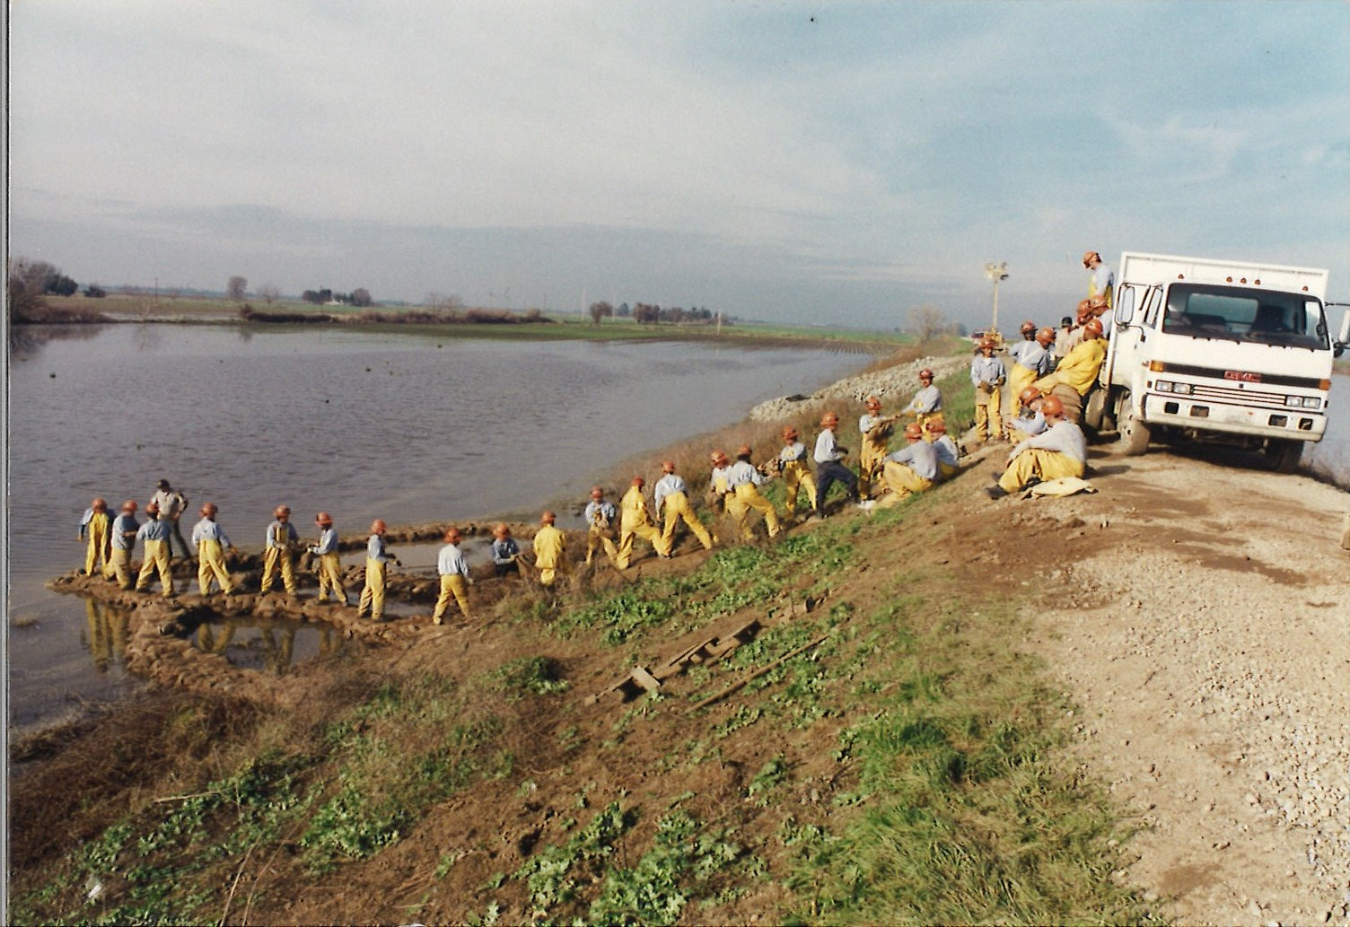
AREAS OF PLANNING FOCUS
Levee Maintaining Agencies
Command and Control
Innovative Plan Formats
Innovative Training Approaches
Regional Consistency
Jones 2004 Break, Command Center
[6]

Slide 3
DOCUMENTED METHDOLOGY
Fire & Law
  Common technical approach to plan development
  Guide to Developing Flood Safety Plans (AB156 Compliant)
  Common GIS mapping technical approach
  GIS Flood Contingency and Evacuation Map
  Technical Memorandum
  Standardized Regional Systems
  On-Going Integrated Planning physically occurring at the lowest local level
Flood Safety Plans
State
County
Levee Maintaining Agencies
and
Local Knowledge
5
Notes:
The locals know their system better than anyone, thus making them the best resource.
Encouraged them to self-evaluate, ask themselves questions AND answer them, that they otherwise wouldn’t have
KSN provided guidance on AB156 and FEMA expectations for LMAs to be reimbursed.
RD1500, RD108 and RD70-1660 are right next to each other, Andy is a new guy Max is full of wisdom. During our meetings, if Andy couldn’t’ answer the questions we would suggest what RD1500 or RD108 is doing. RD108 took some of RD1500’s map requests.

Slide 4
  LMA Emergency Operations Plan
  Flood Contingency Map
  “Behind-the-Levee Engineering”
  Unified Commands w/Map
  Special Case Maps
  Flood Response Command and Control Manual
Levee Maintaining Agencies
Command and Control
Innovative Plan Formats
Innovative Training
  GIS Technical Manual
  Real-Time Capabilities
  ArcGIS Online
  Google Earth
  Just In Time Training Courses
  Regional Training Manual and Agreement

Slide 5
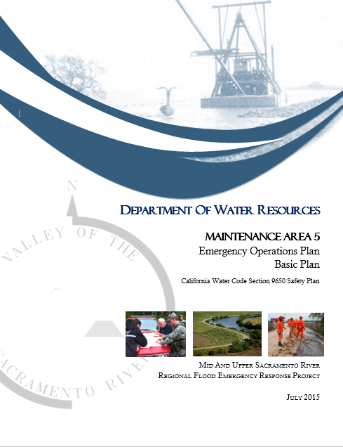
project flood response products:
EMERGENCY OPERATIONS PLAN
SEMS/NIMS Compliance
Formal Designation of LMA Incident Commander
Clearly Defined Authorities
Response Activation Triggers
Procurement Protocols
Cost Recovery Documentation
EMERGENCY OPERATIONS PLAN
(Basic Plan)
Notes:
-Assure NIMS/SEMS compliance, i.e. YOU MUST ACTIVATE YOUR INCIDENT COMMAND appoint an IC, blah blah
-WHO is responsible AND liable for what (county vs. district, general manager vs. board member, etc.)
-When is the IC kicked in, when do patrols start, when do you call DWR, etc.
-Procurement policy, some didn’t have any
-EOP educates and prepared the LMAs, typically thin on staff and resources, to make sure all their ducks are in a row to get disaster reimbursements (having MOUs with their fam staff, documenting everything, moving to an IC system, etc.)

Slide 6
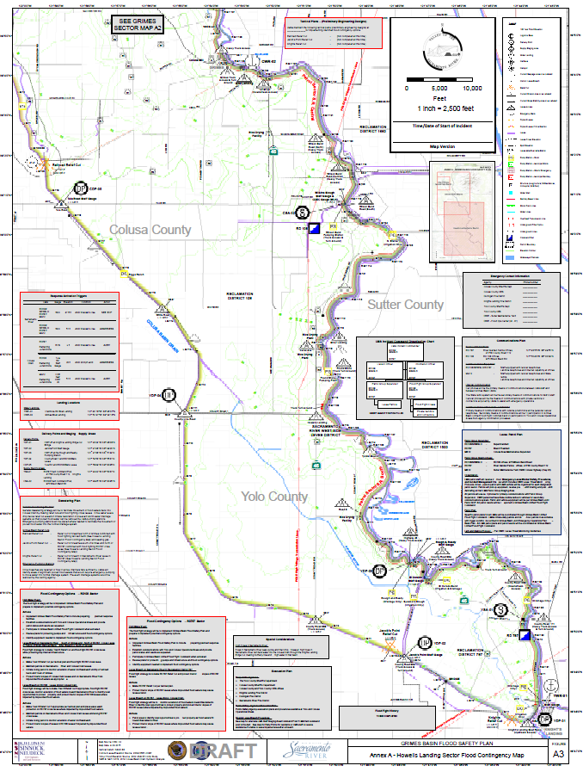
project flood response products:
Critical infrastructure;
LMA organization, patrol, and logistics, and tactical facilities
Levee failure scenarios with containment and dewatering options; and
Well-thought out use of cartographic cognitive tools to display information.
FLOOD CONTINGENCY MAPS
Flood Specific Annex
(Flood Contingency Map)
Notes:
GIS will be discussed separately
Standardizes symbols in San Joaquin, Solano, Yolo, + 7 counties to the north. Though not officially the standard, they do have a strong regional presence recognized by most LMA’s. These symbols are developed based on the FEMA emergency response symbology

Slide 7
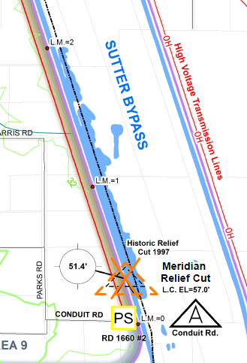
project flood response products:
FLOOD CONTINGENCY MAPS
(Excerpt from Flood Contingency Map)
Notes:
GIS will be discussed separately
Standardizes symbols in San Joaquin, Solano, Yolo, + 7 counties to the north. Though not officially the standard, they do have a strong regional presence recognized by most LMA’s. These symbols are developed based on the FEMA emergency response symbology

Slide 8
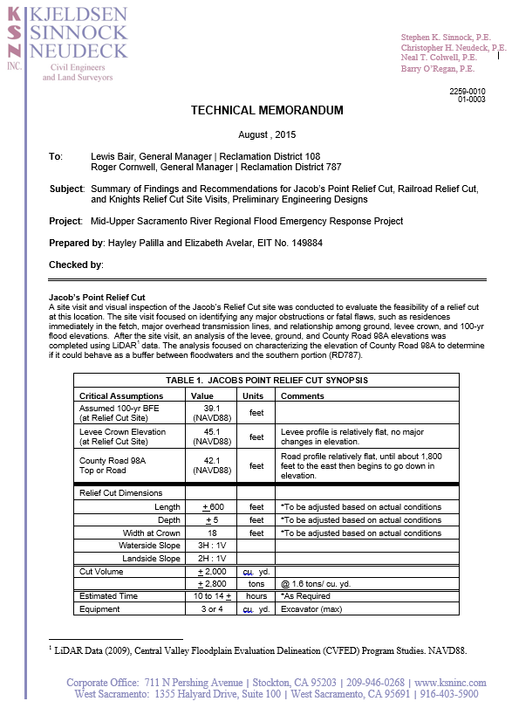
project flood response products:
“BEHIND-THE-LEVEE ENGINEERING”
Our project approach allows for more effective second-stage planning to be performed:
Preliminary Engineering Designs (PED)
  Relief Cuts
  Use of Existing Dryland Levees
  Emergency Berms
  Sealing Underpasses
  Siting Emergency Pumps
Notes:
These are options, info is provided in order to make a decision

Slide 9
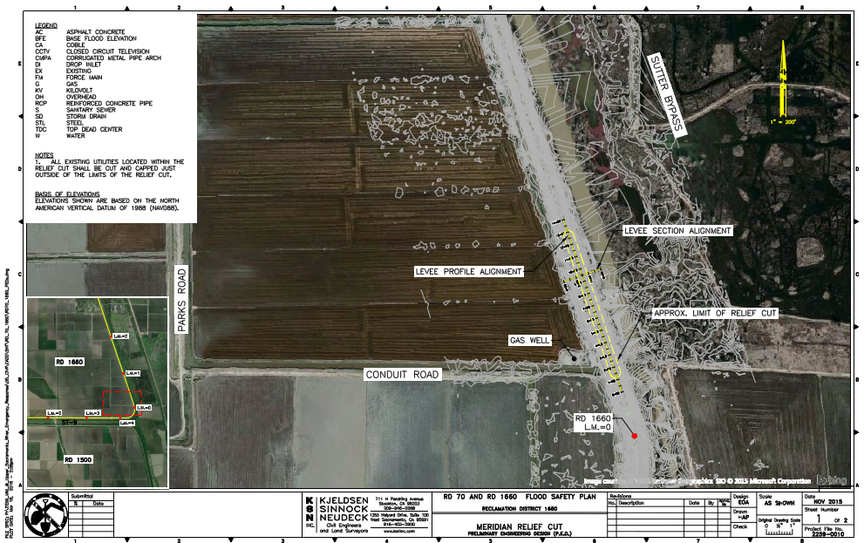
project flood response products:
“BEHIND-THE-LEVEE ENGINEERING”
Notes:
These are options, info is provided in order to make a decision

Slide 10
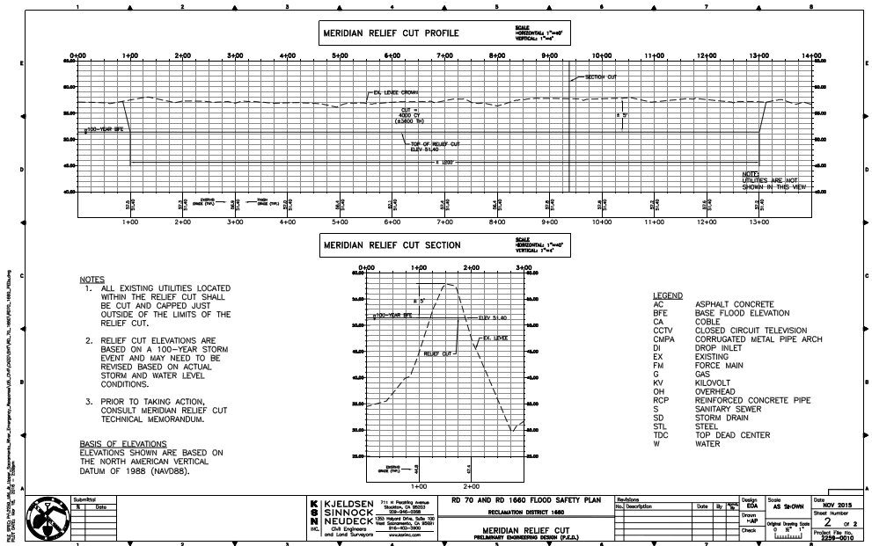
project flood response products:
“BEHIND-THE-LEVEE ENGINEERING”
Notes:
These are options, info is provided in order to make a decision

Slide 11
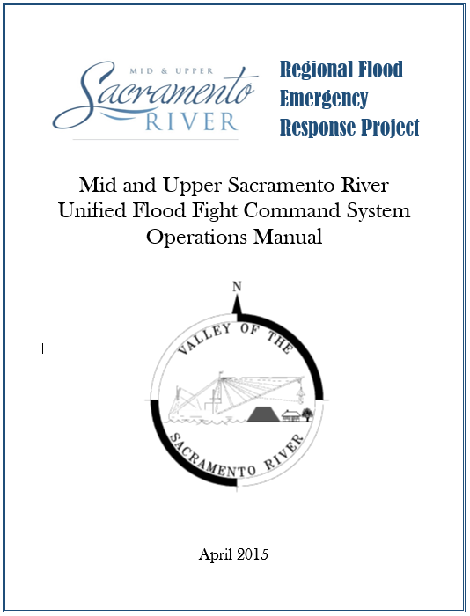
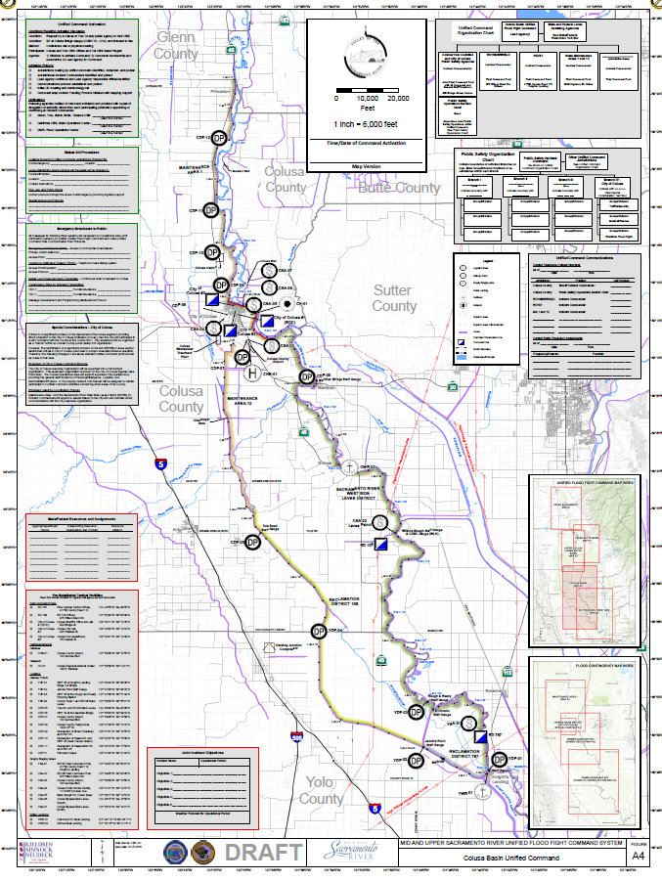
project flood response products:
UNIFIED COMMANDS
Unified Flood Fight Command System Operations Manual
Unified Flood Fight Command (UC Map)
Notes:
Forces everyone to talk to eachother…where the magic happens
-

Slide 12
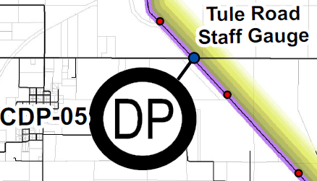
project flood response products:
UNIFIED COMMANDS
Integrated field decision making and organization
Pre-planned regional response facilities
Streamlined Mutual-aid process
Special-Case Public Safety Maps
Unified Flood Fight Command (UC Map)
Notes:
Forces everyone to talk to eachother…where the magic happens

Slide 13
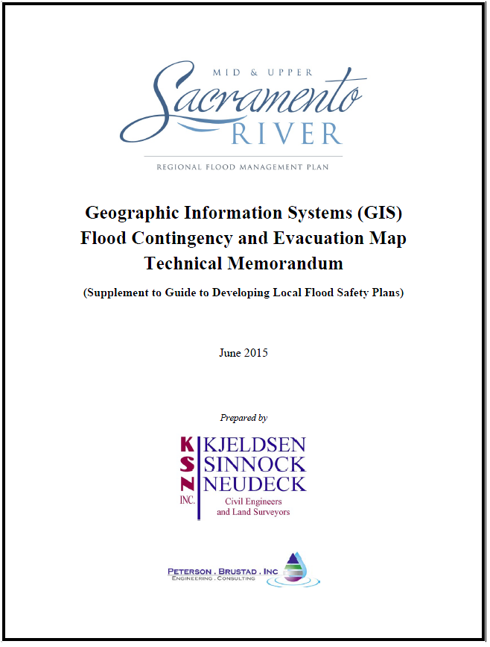
project flood response products:
STANDARDIZED GIS MAPPING SYSTEM
Region-wide standardized GIS protocols to facilitate multi-jurisdictional assistance
Real-Time Mapping Capability
Notes:
Forces everyone to talk to eachother…where the magic happens

Slide 14
project flood response products:
Innovative Training Approach
Recognize Training Challenges
Time between floods
Reliance on Volunteers
Personnel Turn-over
Realistic Training Goals
Just-In-Time Training Program
Basic ELW Course
Flood Responder Course
Web-Based Flood Fight Methods Course
Web-Based Flood Safety Plan Review Course
Regional Flood Emergency Response Training System
Basic Emergency Levee Worker (ELW) course
Notes:
Forces everyone to talk to eachother…where the magic happens

Slide 15
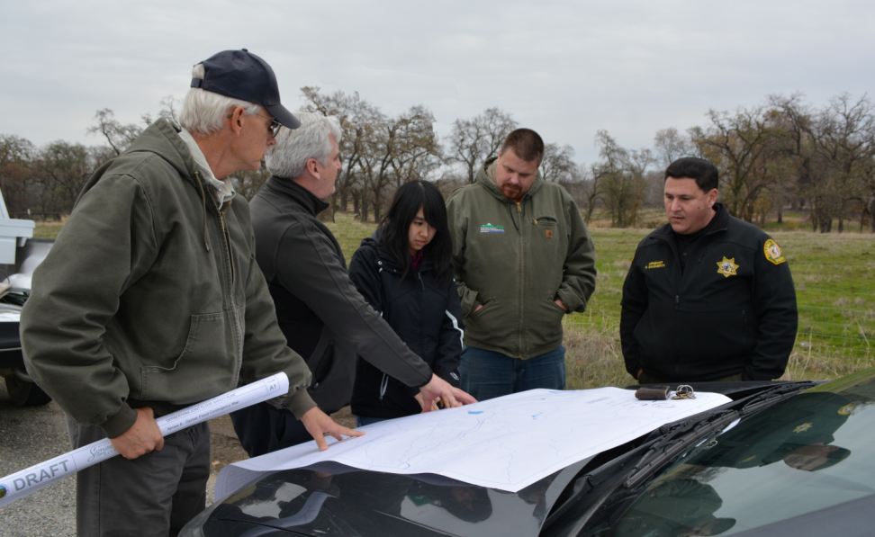
Next phase
Regional Flood Fight Stockpile System
Exercise the new Response System
Expand “Behind-the-Levee Engineering”
Critical gauge datum conversions
Underpass Pop-Up Gates
Relief Cut Preparation
Tactical Facility Improvement
Future Work
Critical gauge datum conversions
Levee Turnarounds
Dryland levee improvements
[8]

Slide 16


Thank you
Questions?

Slide 17
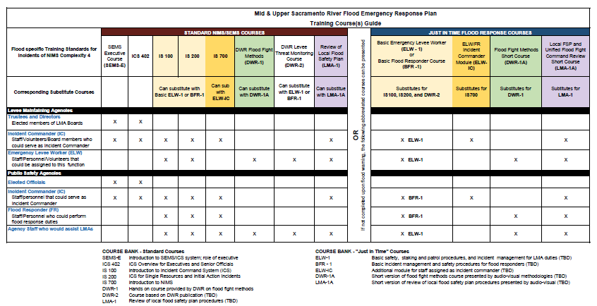
17
Notes:
Adjust somehow

